Slide 1
CoLab.online Reducing the Stress of Collaborative Work for You and Your Teams
Micah Gideon Modell
https://CoLab.online
http://PeerAssess.info
Notes:
My name is Micah Modell. I’m a professor at Mount Saint Mary College and I’d like to ask for your help in solving a problem.

Slide 2
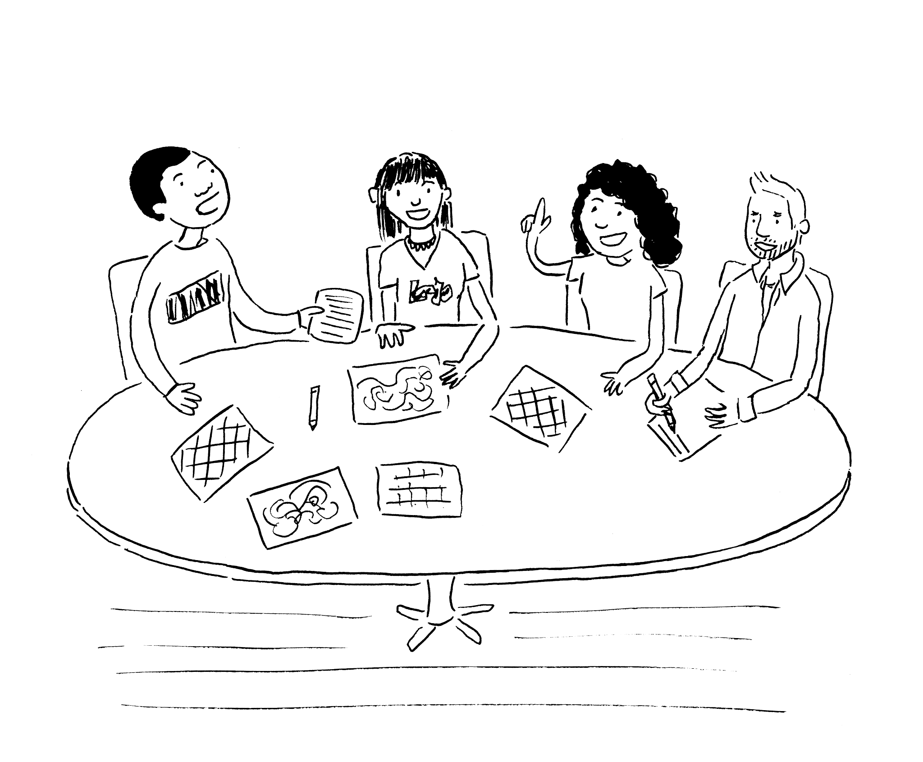
Does your dream of teamwork…
Manpower
Skills
Perspective
Notes:
I think I’m decently smart and thoughtful and whatnot, but I love to bounce my ideas off of other people to gain a fresh perspective on them. I love having a team I can ask for help when I need it - and I often need it. I love being able to tackle bigger projects and get them done faster than I could alone - even if I had already had all the skills.
It turns out that educators across fields use teams for these same reasons plus one more: business employs teams and they want students that are good team citizens. They want employees that can:
work effectively with their teammates
Grow their skills by observing and helping others
Synthesize diverse perspectives into innovative approaches to their work
Working with other people always complicates things and isn’t expected to make things easier, but it should make the process and the outcomes more rewarding - if it’s done right.

Slide 3
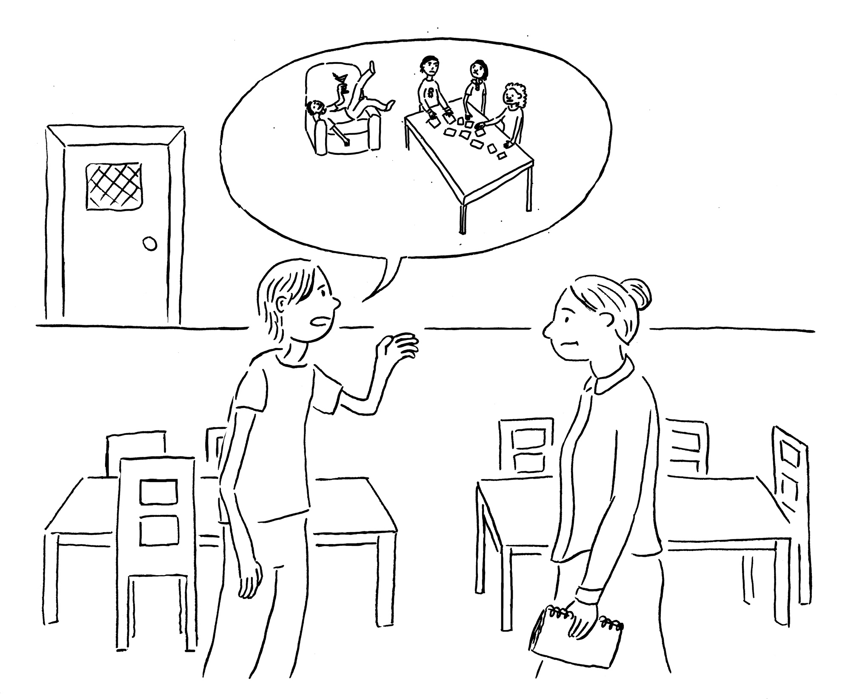
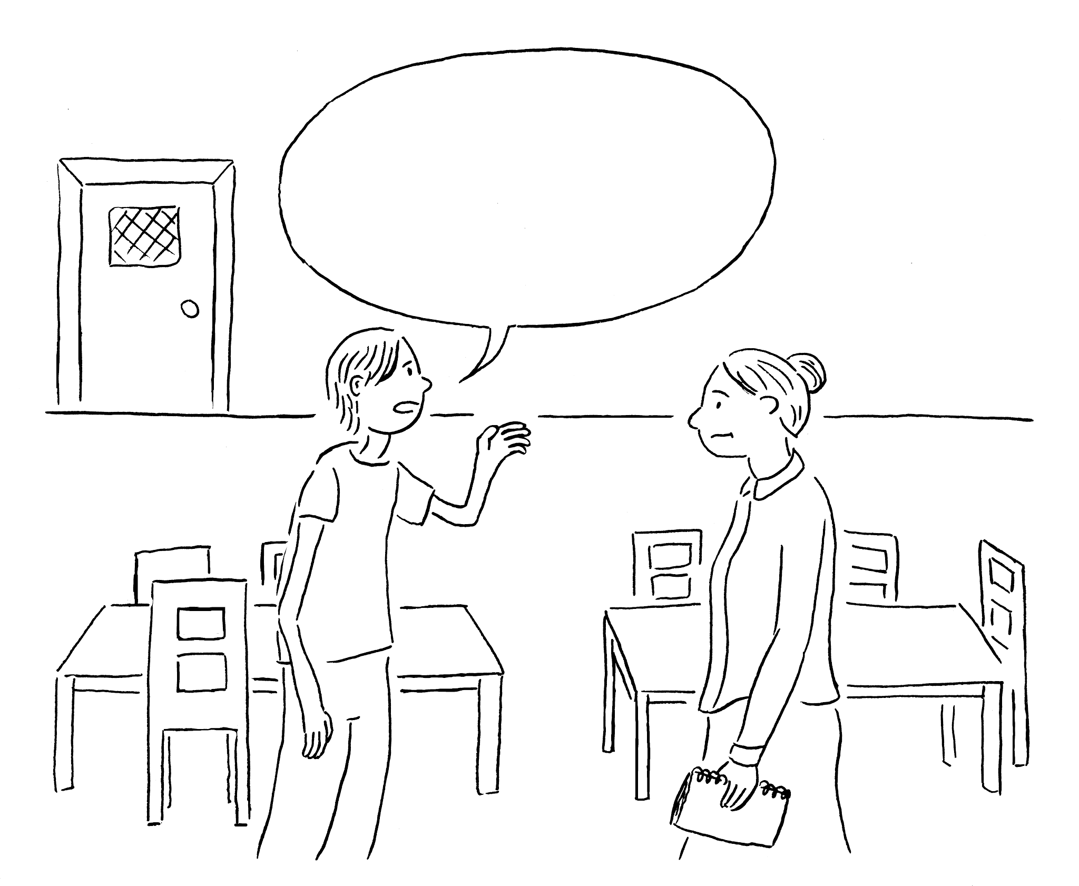
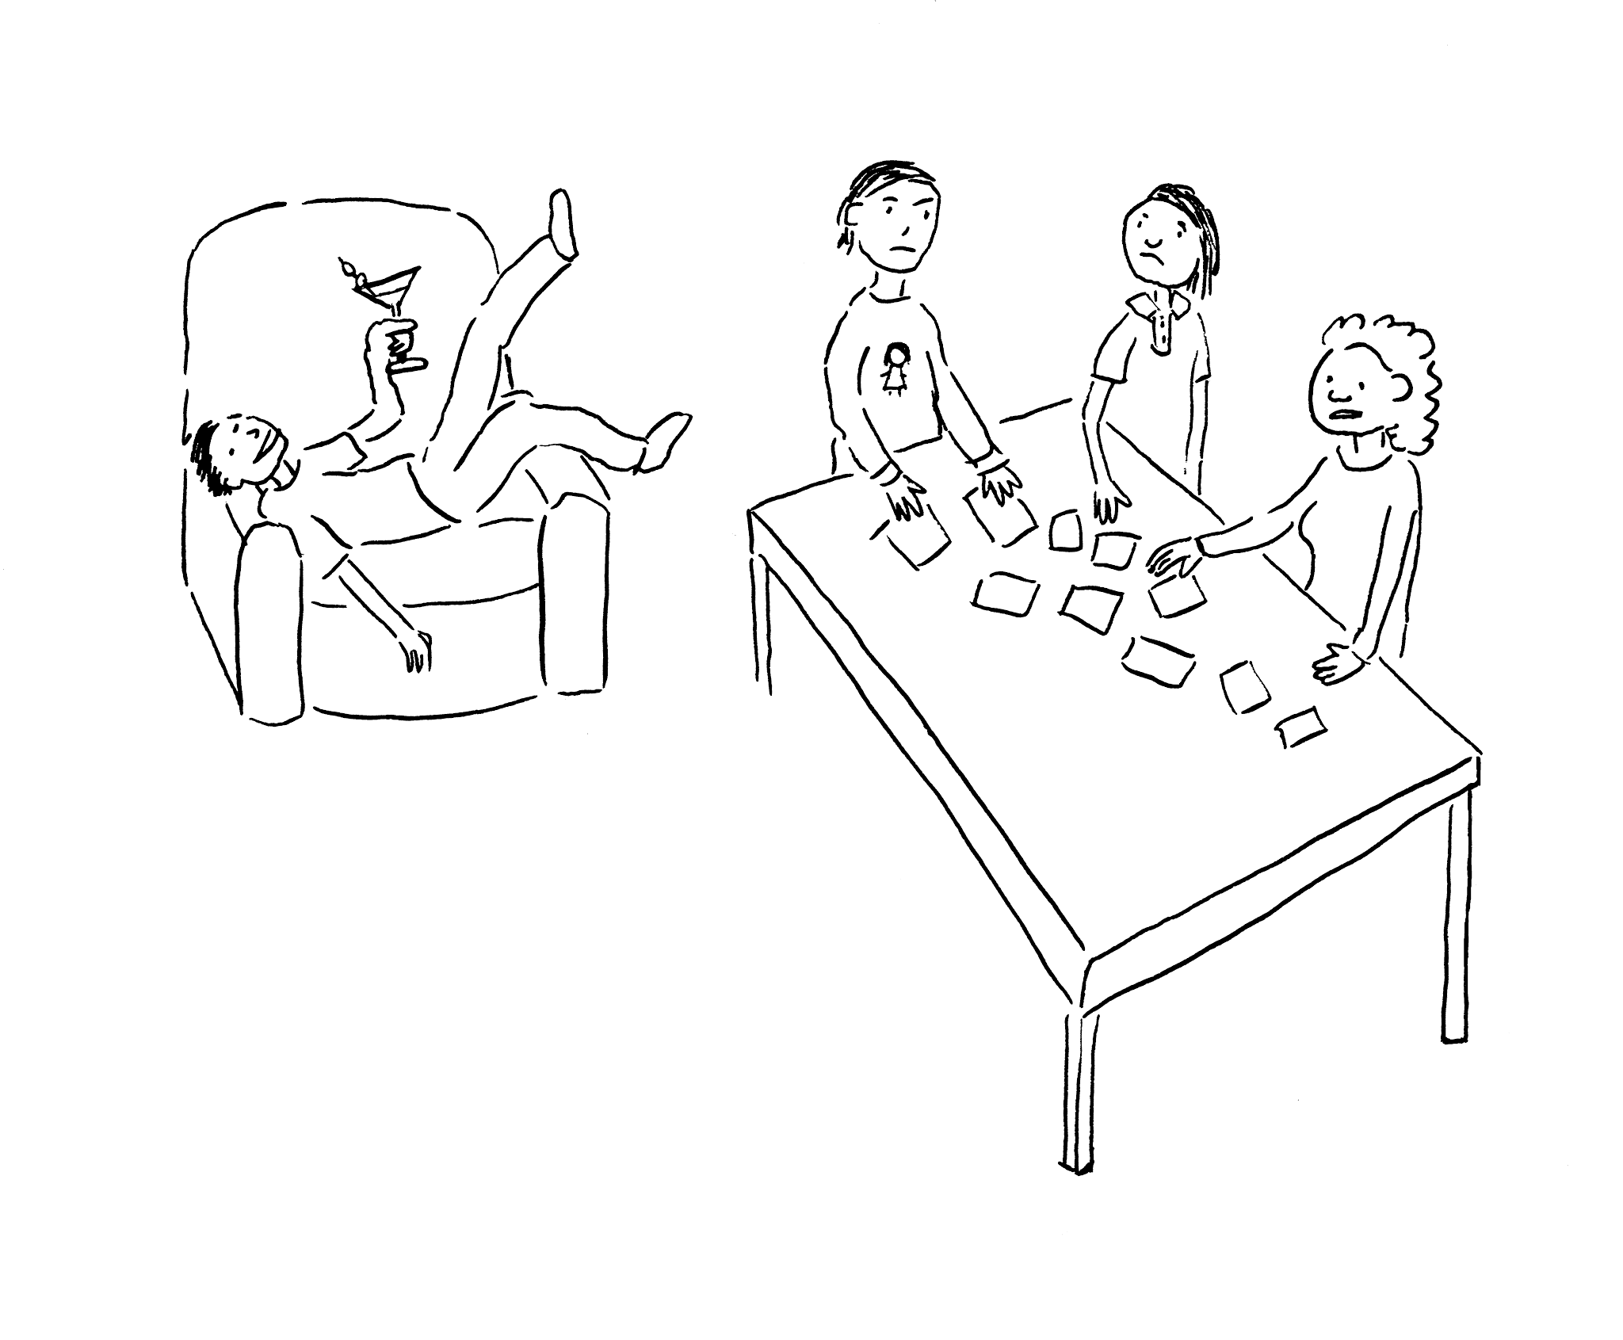
Often turn into this?
Notes:
Unfortunately, while we might dream of this…
We are often met with students who report a sub-optimal experience.
Maybe this is familiar? It’s the end of the semester
and one team member reports that while he and some colleagues have been working hard, one of their team member hasn’t been carrying their fair share of the load.

Slide 4
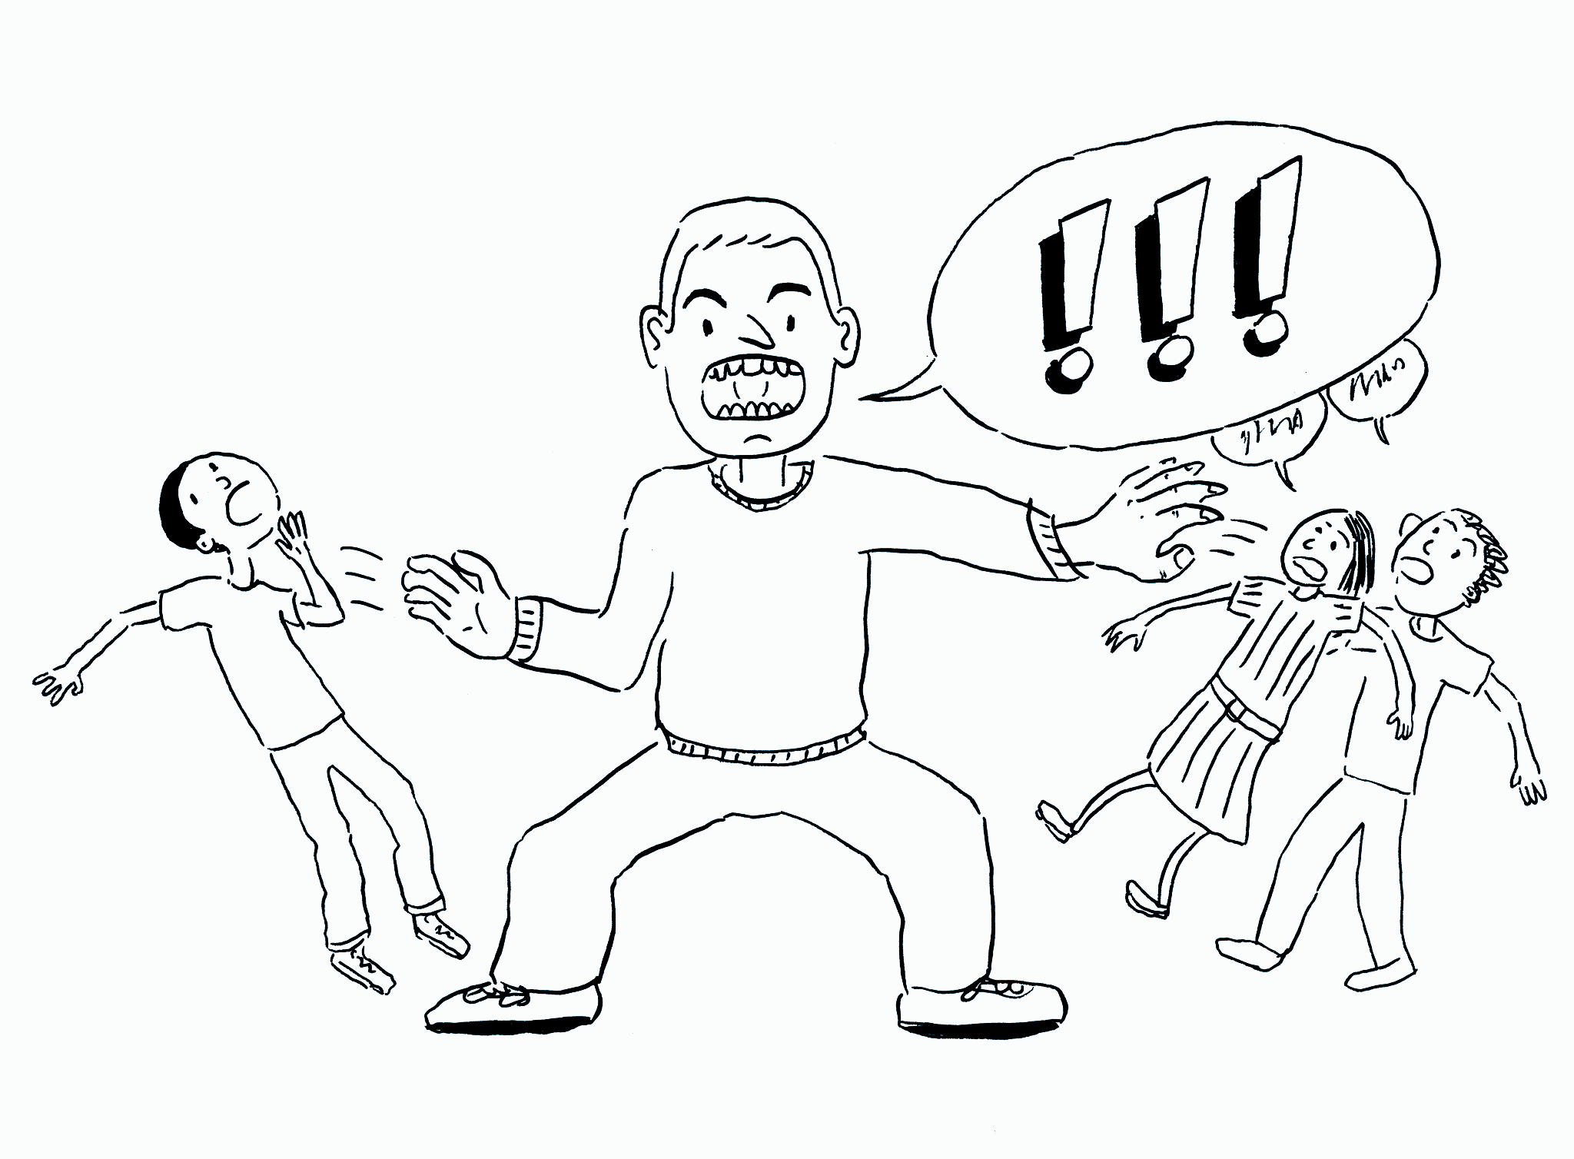
Or this?
Notes:
Or maybe the one with all the skills keeps getting handed more and more of the work because, of course, they are so capable?
Others of us will feel oppressed by a dominating personality? In fairness, I'm afraid I've probably been that dominating personality on more than one occasion.

Slide 5
Or maybe the ”creative” results are mostly the same?
Notes:
And how often do we find our hard work is met with passable but uninspiring results that hardly seem worth the additional effort?
We hoped for innovation, but were met with replication.
These are the problems I’m trying to address.

Slide 6
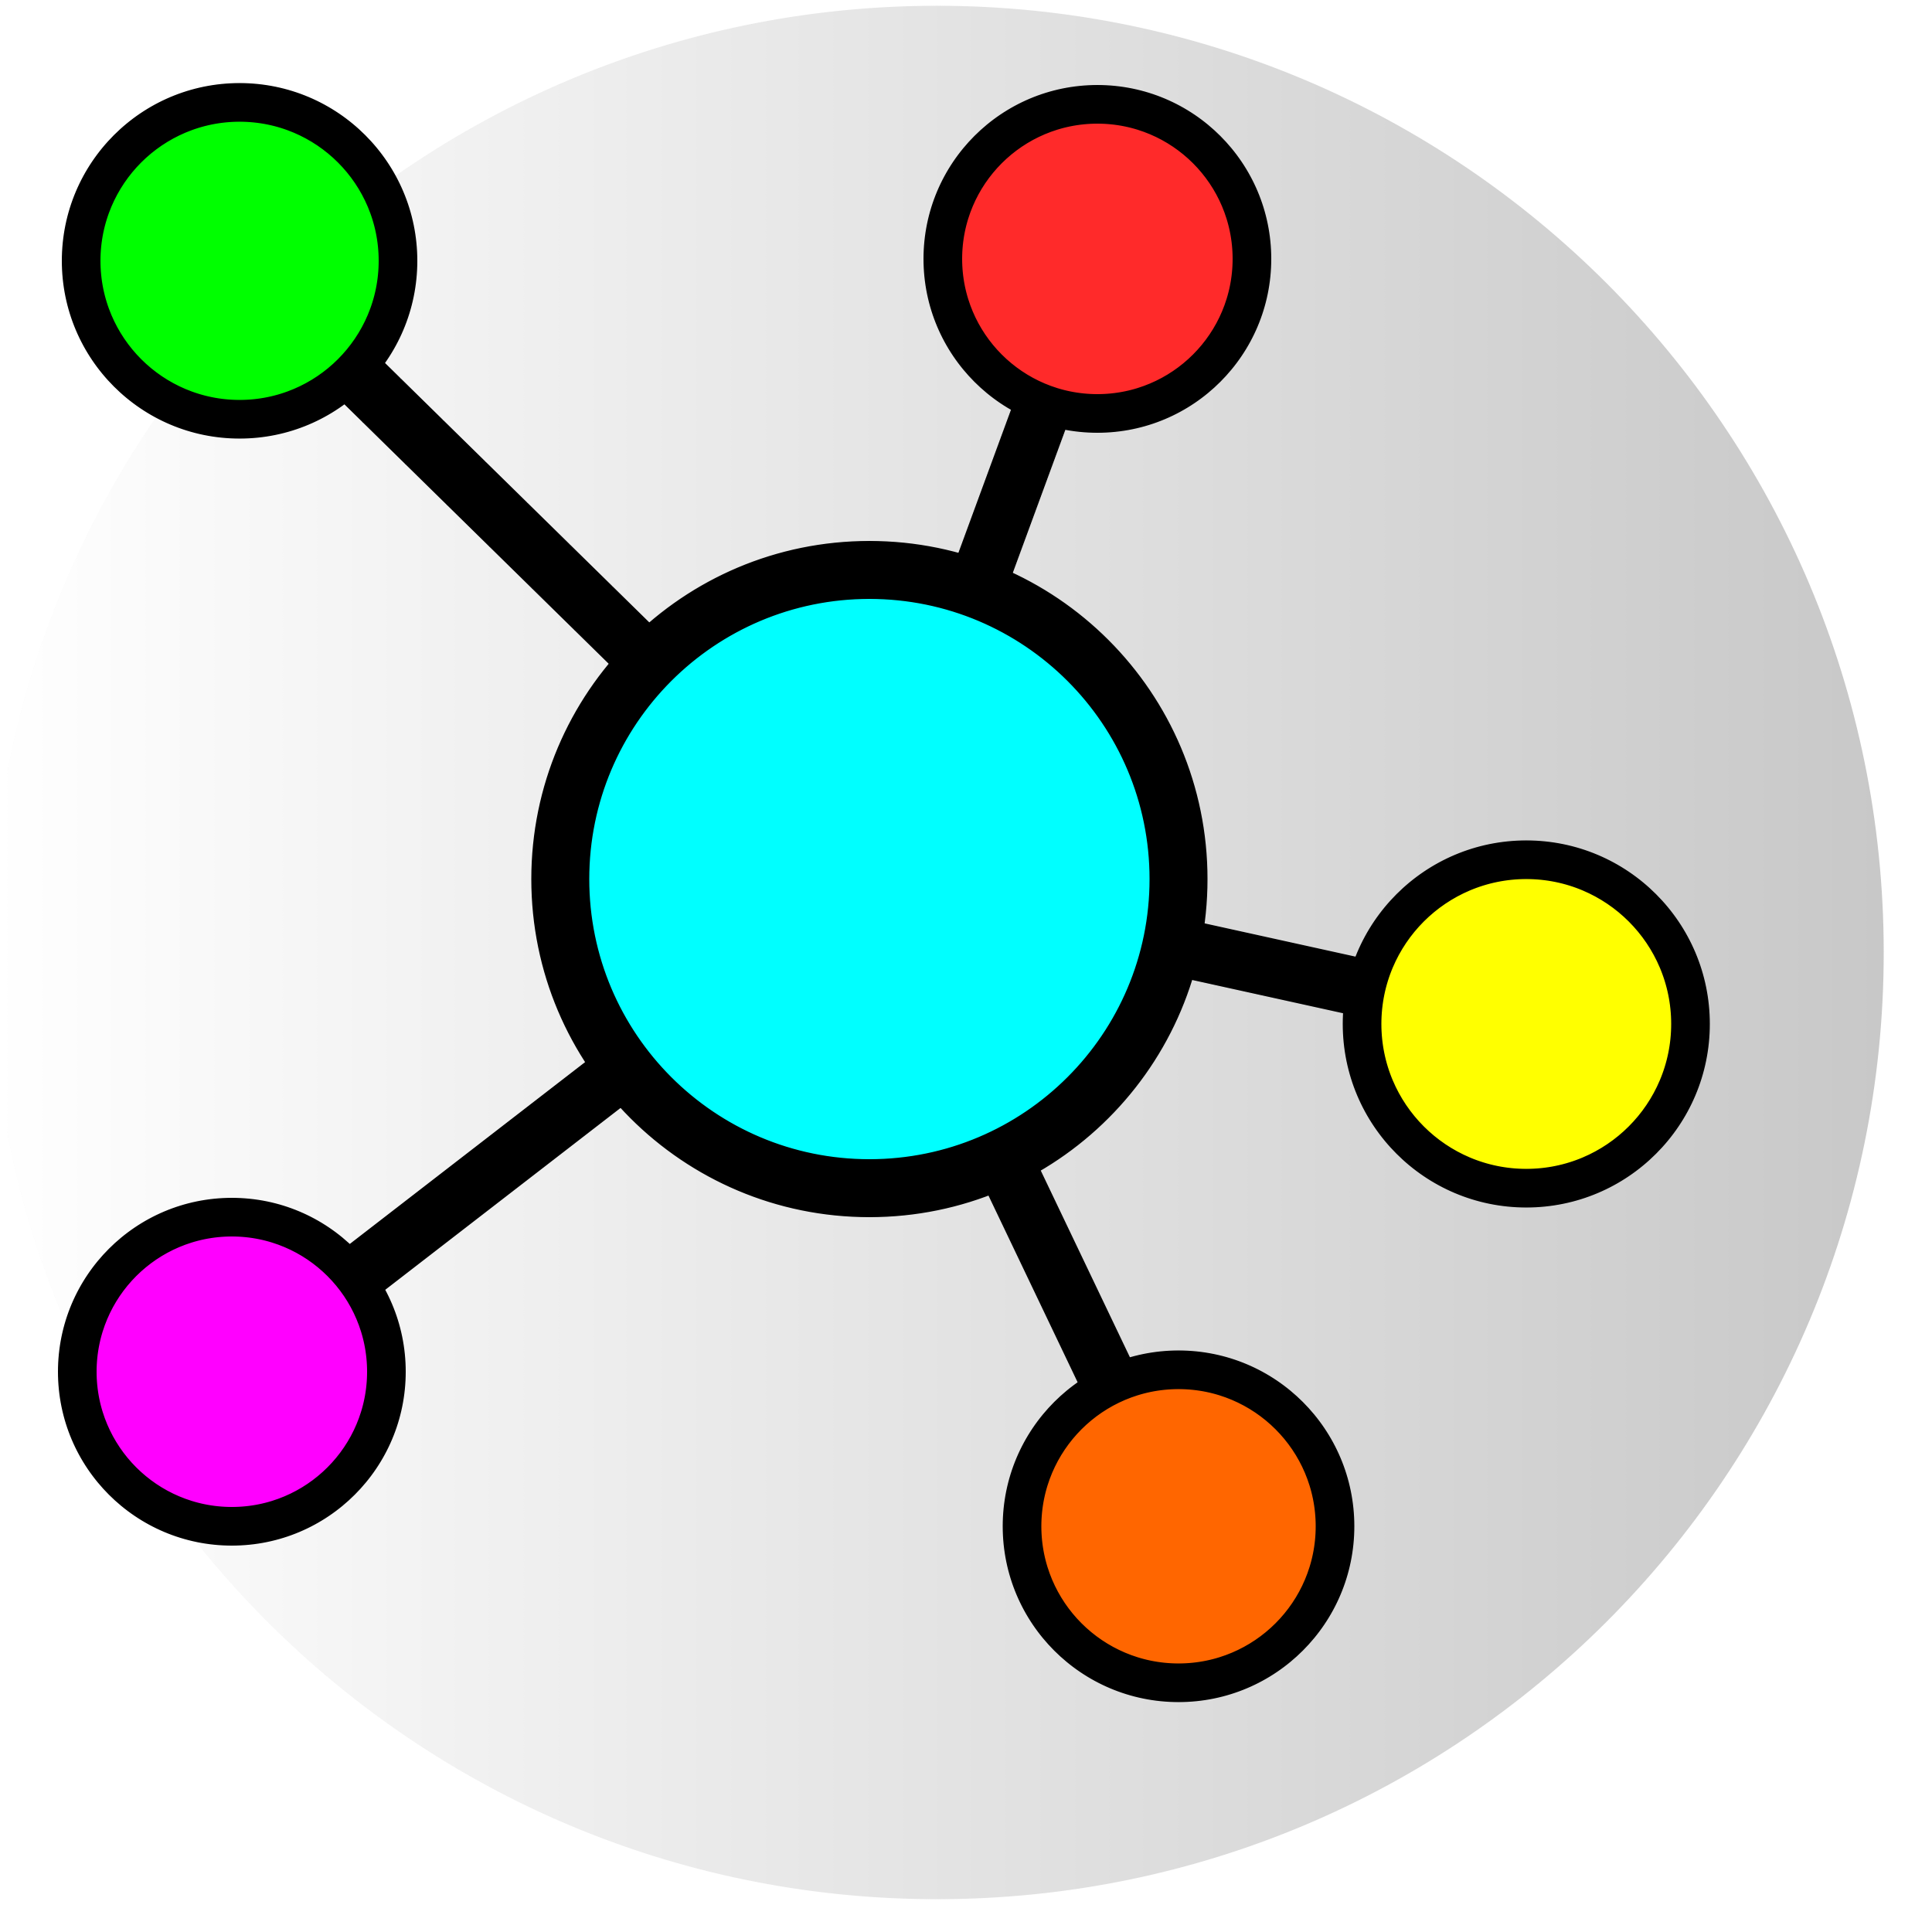
CoLab.online can help!
Self- and peer-assessment
Focused on groups (not individuals)
Weekly data collection
Visualizations
Diversity-focused group composition
And more!
Notes:
That’s why I’ve been working on building out CoLab, a collaboration support platform offering self and peer assessment. CoLab focuses on presenting instructors with a comprehensive picture of group health over the course of a semester to help instructors guide students throughout the semester.
*Video
Students are emailed weekly to tell their instructor the levels at which they and their teammates contributed to the functioning of the group. Students are asked to tell what they saw along multiple behavioral dimensions.
Importantly, the zero-sum setup focuses on the group dynamics and not individual performance. If I try to reward my best friend, Janice, it takes away from the rest of the team. Once they’re happy with their report, they hit submit.
Then, instructors can see this data visualized. In this case, it looks like they were storming for about 2 months and gradually coalesced into a functional group. In the second half they seem not to have felt the need to spend much time on this – and that’s fine – the end shows they still had voices.
This next group was obviously more challenged. In this case, some teammates perceived Tammy and Joseph – those aren't their real names. Everything’s routinely anonymized to support research – Anyway, teammates perceived Tammy and Joseph as struggling to participate and you can see that their teammates had to pick up the slack for them. These yellow dots indicate that some of them even felt compelled to write in comments.

Slide 7
Come to the CoLab demo to learn to…
Notes:
So, why this talk?

Slide 8
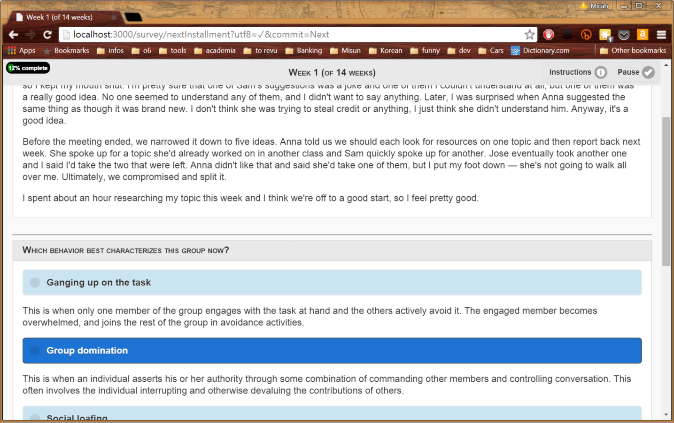
Deploy Teamwork Simulations
Students:
Read journal entries
Diagnose problems
You debrief them using their insights
Notes:
This image shows an example of one of the simulation exercises. Students read through 12 weeks of journal entries and then they’re asked to reflect on how the team performed and how it might be improved upon. These suggestions are captured and provided for use by the instructor to spur discussion…

Slide 9
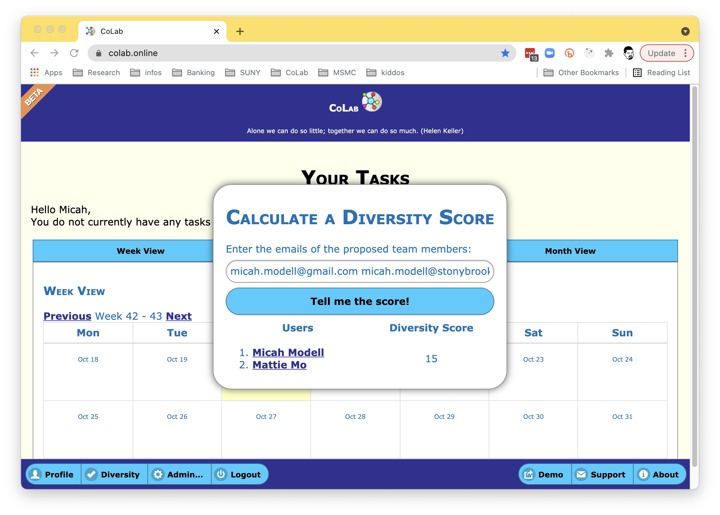
Launch Teams
Calculate diversity/perspectives
Simulate teamwork experience
Facilitate diversity discussions

Slide 10
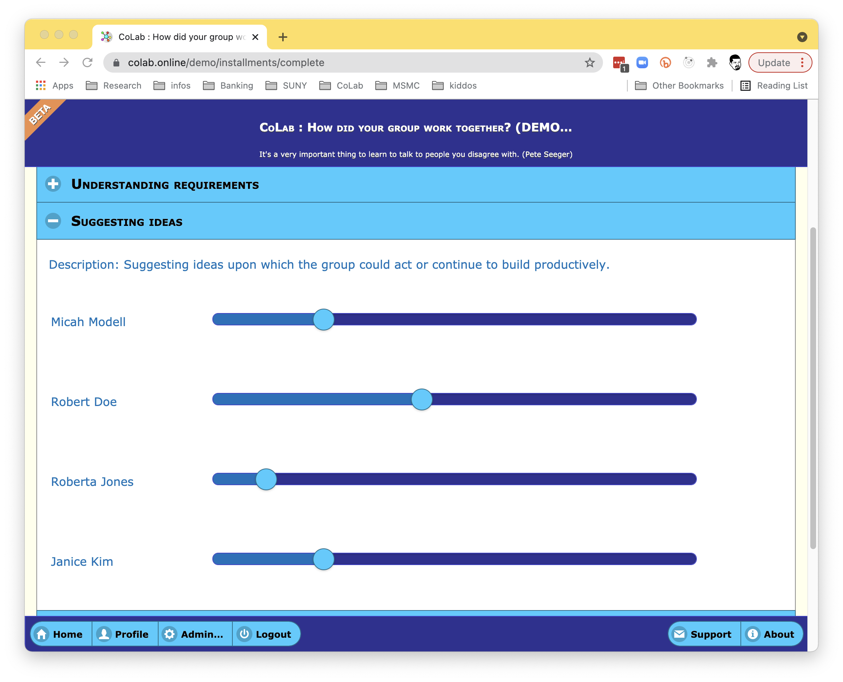
Have Students Check In
Linked sliders
5 minutes or less
Email reminders

Slide 11
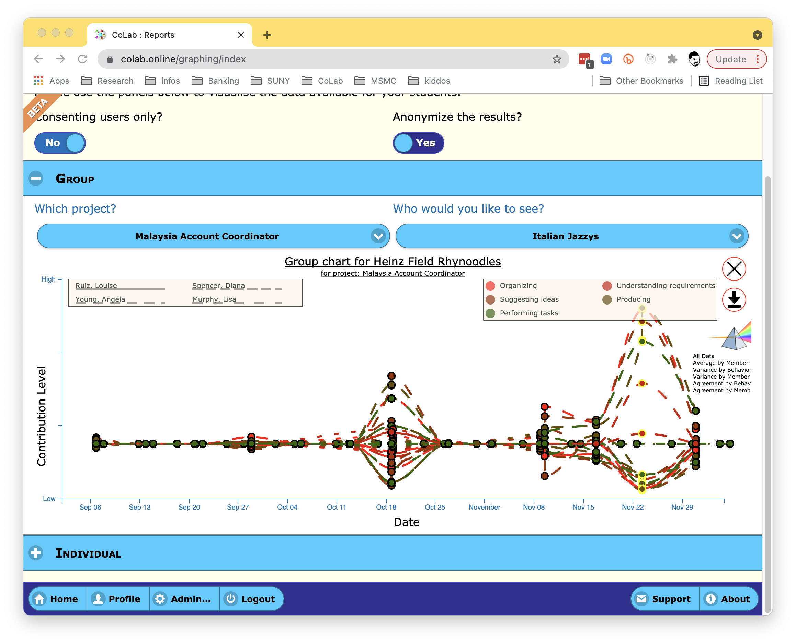
Review the Data
Visual
Interactive
Color/Texture-coded
See when to intervene!

Slide 12
CoLab.online
Build students into valuable team citizens.
9.45am Saturday, March 5
Exhibit Hall C/D
Notes:
That’s why I’ve been working on building out CoLab, a collaboration support platform offering self and peer assessment. CoLab focuses on presenting instructors with a comprehensive picture of group health over the course of a semester to help instructors guide students throughout the semester.
*Video
Students are emailed weekly to tell their instructor the levels at which they and their teammates contributed to the functioning of the group. Students are asked to tell what they saw along multiple behavioral dimensions.
Importantly, the zero-sum setup focuses on the group dynamics and not individual performance. If I try to reward my best friend, Janice, it takes away from the rest of the team. Once they’re happy with their report, they hit submit.
Then, instructors can see this data visualized. In this case, it looks like they were storming for about 2 months and gradually coalesced into a functional group. In the second half they seem not to have felt the need to spend much time on this – and that’s fine – the end shows they still had voices.
This next group was obviously more challenged. In this case, some teammates perceived Tammy and Joseph – those aren't their real names. Everything’s routinely anonymized to support research – Anyway, teammates perceived Tammy and Joseph as struggling to participate and you can see that their teammates had to pick up the slack for them. These yellow dots indicate that some of them even felt compelled to write in comments.

